Slide 1
Symbolism in Santiago and Hester’s Survival Journey
Presented by: Bappi Rani Das

Slide 2
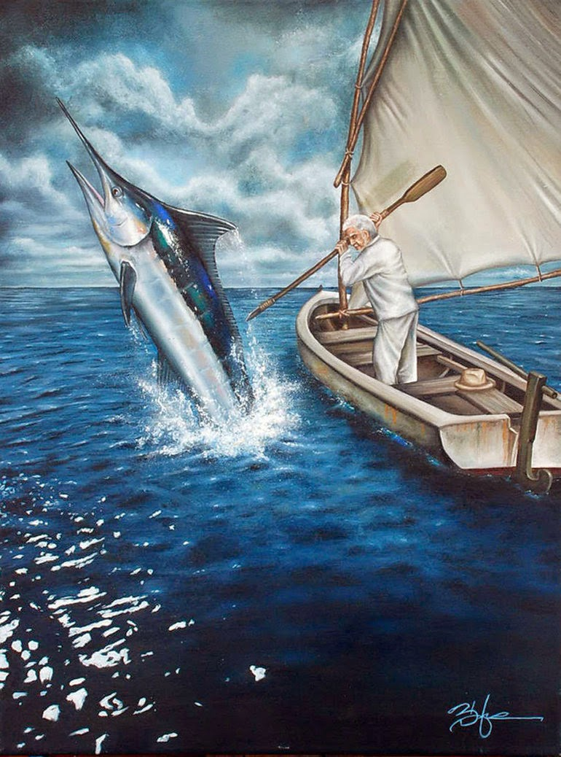
Marlin
Achievement
Struggle

Slide 3
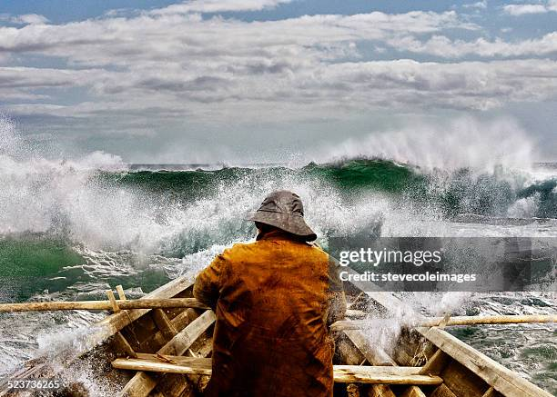
The Duality of Nature
Isolation

Slide 4
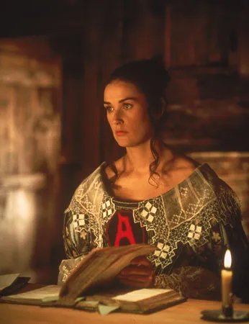
Shame
Transformation

